Slide 1
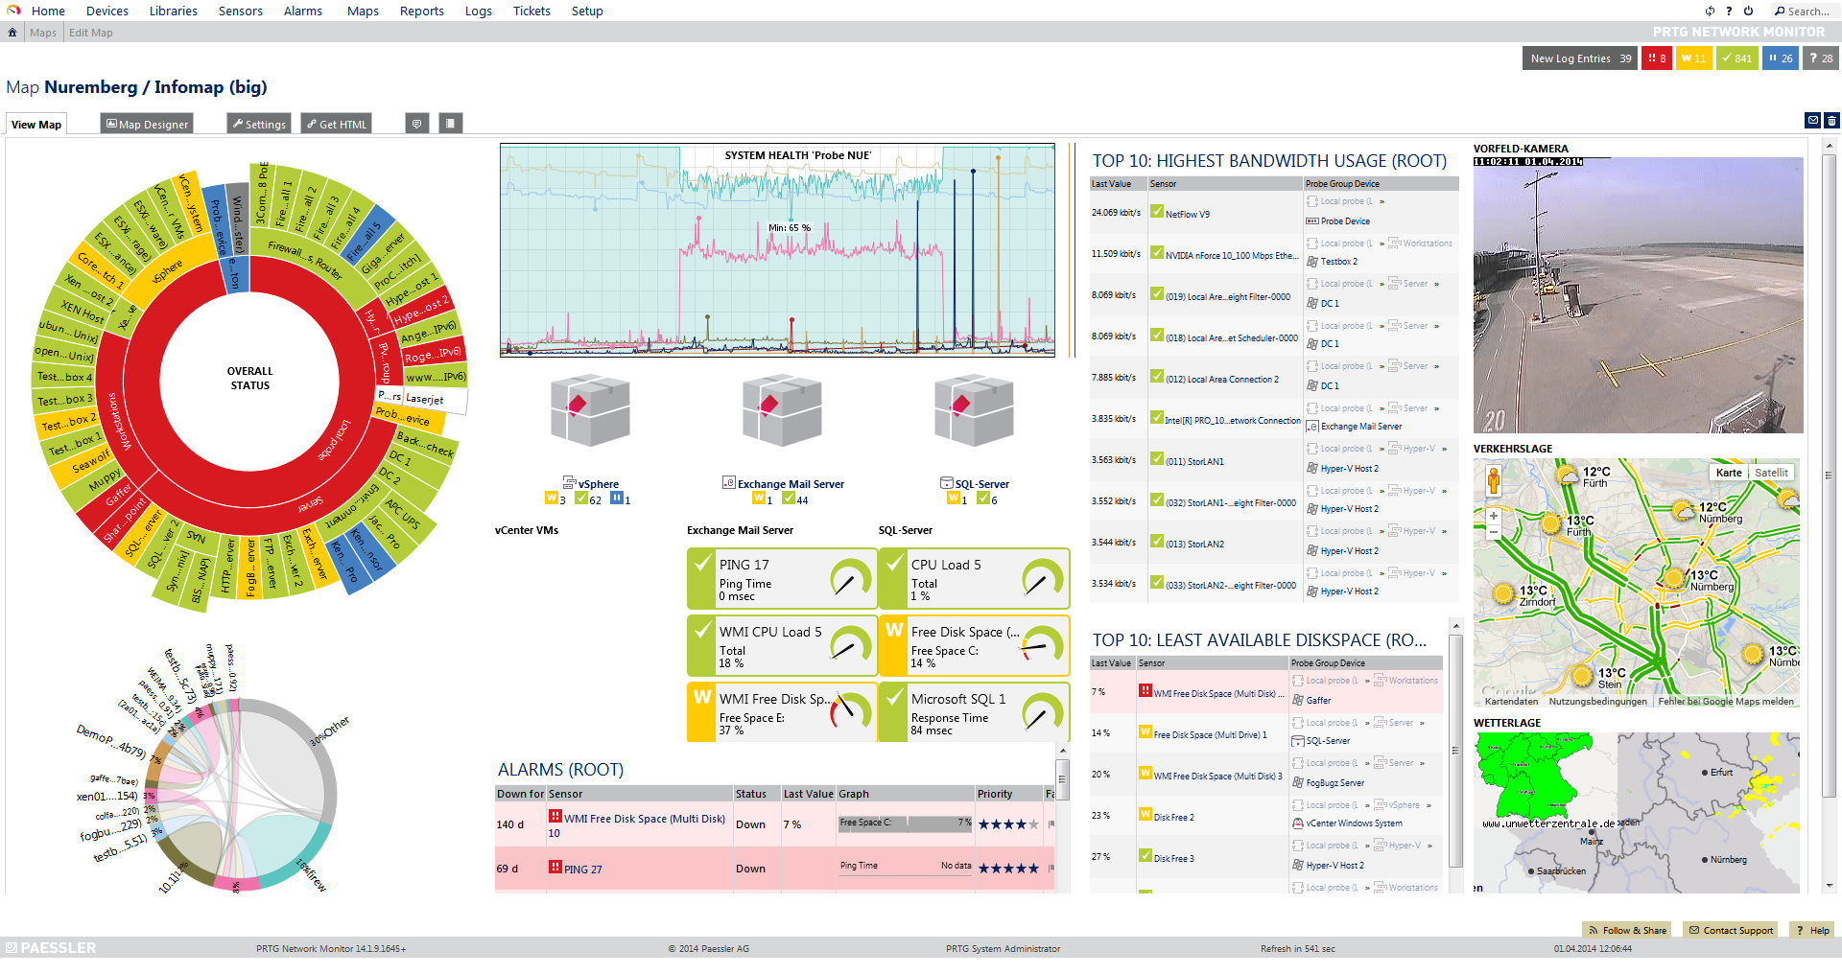
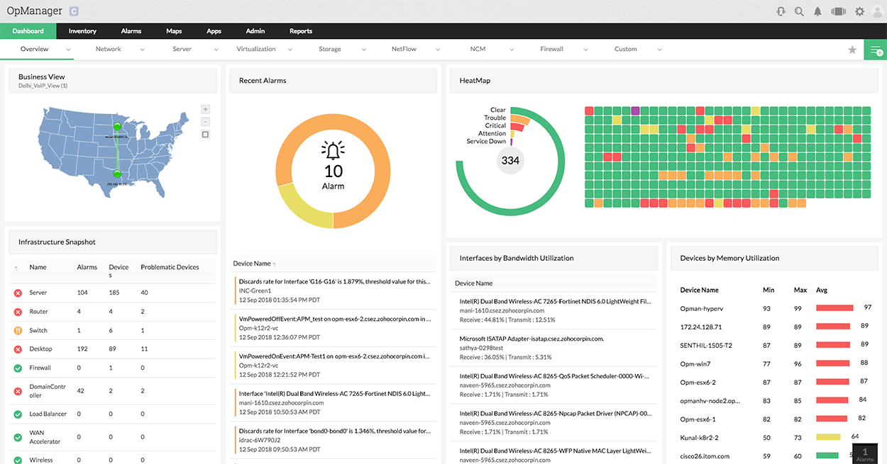
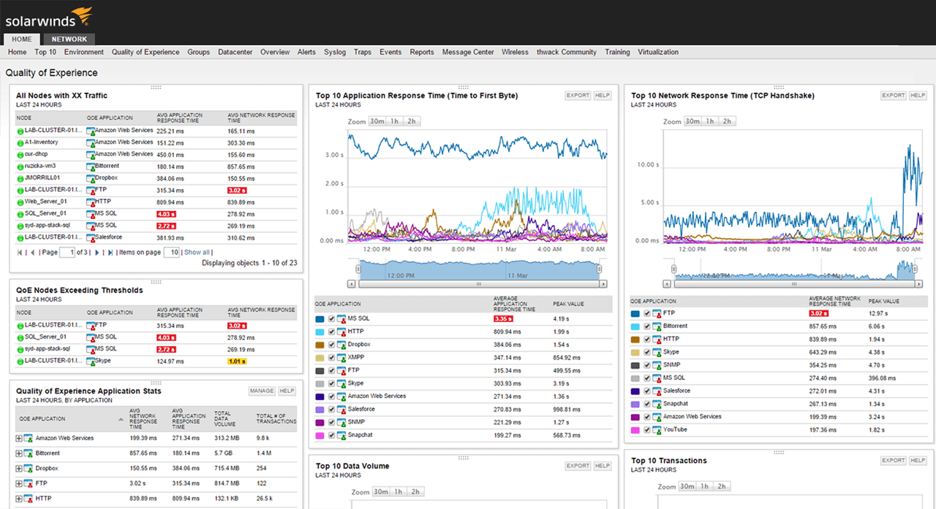

Slide 2

Why We Need Network
Monitoring?
Device Discovery
Network Maps
Understand Device Health Status
Long-Term Hardware Trends
Network Traffic Analysis
Alerting and Incident Response
Ali Mansouri
Network Monitoring instructor

Slide 3
Why We Need Network
Monitoring?
Manage Network Devices
Cloud Integration
Analyse Wireless Connectivity
Monitor Application Health
Ali Mansouri
Network Monitoring instructor

